Slide 1
INECO
Management Review Process
Presentation Outlines - Analytical
For Meetings – August 17, 18 & 22

Slide 2
FY12 Planning & Forecasting
Why Planning?
  Good practice for well-run company
  Help you think about improving your business
  Identify and plan for growth opportunities

Slide 3
FY12 Planning & Forecasting
Objectives
  Deliberate plan for growth
  3 year business forecast
  On time!

Slide 4
INECO Management Review
Review - Outline
INECO MR Confidential August 2011
FY 2011 Business Results
  11 YTD Performance to company plan, total business unit
  11 YE Forecast (including assumptions made in the YE forecast)
  Conclusions FY11
Executive Summary of FY 2012 Objectives & Strategies
FY 2012 Sales and Revenue Forecast
  Expectations for the market
  Factors causing INECO to exceed market growth
  Factors causing INECO to grow below market rate
  Forecast Summary
  MRO and Project FY12-14 Forecast
  Historical Trends
  FY 2012 Sales and Revenue Forecast
FY 12-14 Sales and Revenue Forecast
FY 12-14 Organization & Headcount projections
FY 12-14 CAPEX projections

Slide 5
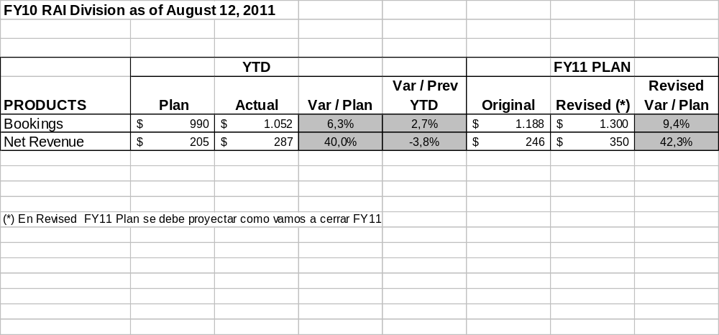
FY10 YE Forecast RAI Division
INECO MR Confidential August 2011
Notes:
Provide products, service and total forecast for the end of the FY.
Include in the notes any assumptions made in the YE FORECAST.
Indicate the probability that each of the assumptions will be realized
Explain, in summary, the reasons for FY09 variance to plan.
Jay Flusche will provide a spreadsheet with the tables needed above

Slide 6

FY11 Conclusions RAI Division
INECO MR Confidential August 2011
Notes:
Provide products, service and total forecast for the end of the FY.
Include in the notes any assumptions made in the YE FORECAST.
Indicate the probability that each of the assumptions will be realized
Explain, in summary, the reasons for FY09 variance to plan.
Jay Flusche will provide a spreadsheet with the tables needed above

Slide 7
FY 2012 Forecast – RAI Division
Executive Summary Objectives
INECO MR Confidential August 2011
Bullet list of objectives expected to be achieved during FY 2012. Bullets should be prioritized.
  Prepare standard solution for environmental local compliance
  Complete Analytical System integration
  Specialist Analytical Services
  Penetration to competence installed base
  Increase Net revenues for MRO
List should be limited to one slide
Notes:
This is a brief overview of the objectives you will take in 2010.
Details of these will be discussed in following slides in the presentation, this is the exec summary slide

Slide 8
FY 2012 Forecast- RAI Division
Market Opportunity Factors
INECO MR Confidential August 2011
Bullet list of factors affecting market spend in FY12 over FY11 (for total market or for specific market segments).
  New requirements of local environmental regulation for Thermoelectric ( 15 to 30 MW)
  Customer segment market factors
  Increase our participation in M&M market for Analytical Product
  Power plant CEMS Application
  Significant projects or orders
    Codelco Acid Plant revamping project
    Carbon Credit Project Enaex Success PANNA 1
    Fuel Gas Analysis For ENAP Aconcagua And Bio Bio
Notes:
In FY11 will the market spend more or less than FY10?
Identify the growth or decline in the total market spend for the products and services (whether the spend is with INECOor others). Describe the market factors that influence this forecast.
Describe if these forecasts (and associated factors) are different for specific market segments (customers, industries, etc.).
Include discussion of significant projects or orders that were available in FY10 that will not be available in FY11 or vice versa.

Slide 9
Example “Waterfall” Chart
2400
 |  |  |  |  |  |  |  |  |  |  | 200 |  | 2200
2200 |  |  |  |  |  |  |  |  | 500
 |  |  |  |  |  |  |  |  |  |  |  |  |  |  |  |  |  | Services
2000 |  |  |  |  |  |  |  |  |  |  |  |  |  |  |  |  |  | System Integr
 |  |  |  |  |  |  |  |  |  |  |  |  |  |  |  |  |  | Wireless
1800 |  |  |  |  |  |  |  |  |  |  |  |  |  |  |  |  |  | Project
 |  |  |  |  |  |  |  |  |  |  |  |  |  |  |  |  |  | Base
1600 |  |  |  |  |  |  | 100
 |  |  |  |  | 200
1400
 |  |  | 1300
1200
1000
800
600

Slide 10
FY 2012 Forecast- RAI Division
Negative Growth Factors
INECO MR Confidential August 2011
Describe those factors that will cause INECO to not achieve market growth.
  Delay environmental or revamping projects
  Do not have prepared sales force in strategic market
  Develop strategic relationship with provider of equipment out of Emerson portfolio
  Do not optimize our integration cost
  Our competitor offer better delivery time than us
Notes:
Describe those factors that will cause INECO to not achieve market growth. Describe the impact that each of these will have on shipments or net revenue ($ or %).
Examples of factors to consider include
Price pressure (reduced top line, reduced net revenue)
Cost pressure (increased cost from suppliers / manufacturers)
Competitor success – PS being displaced by competition
Loss of customers – specific changes in customers, independent of overall market behavior
Loss of products

Slide 11
FY 2012 Forecast- RAI Division
Growth Plans: Price and Margin
INECO MR Confidential August 2011
Describe your initiatives around price and margin.
  Increase 2% our margin for MRO
  Low cost for System analyzer project with local engineering and integration

Slide 12
FY 2012 Forecast- FCS Division
Growth Plans: Strategic Growth Initiatives
INECO MR Confidential August 2011
Describe your plans and initiatives to grow in excess of market conditions
  Customer targeted growth
    Competitive Displacement: testing
    Opportunity creation: Local Integration
  New products
  Service and system for environmental compliance with Engineering and integration by Ineco
  Sales Effectiveness Initiatives
    Improve our Hit Rate focuses to key account
    Margin programs: Increase in MRO and Local integration
Notes:
Initiatives to Grow in Excess of Market can be categorized
1.) Customer targeted growth (with existing products at existing customers)
a.) competitive displacement
b.) opportunity creation
2.) New products
3.) New customers
4.) Sales Effectiveness (hit rate, follow-up, margin improvement,
5.) Other factors

Slide 13
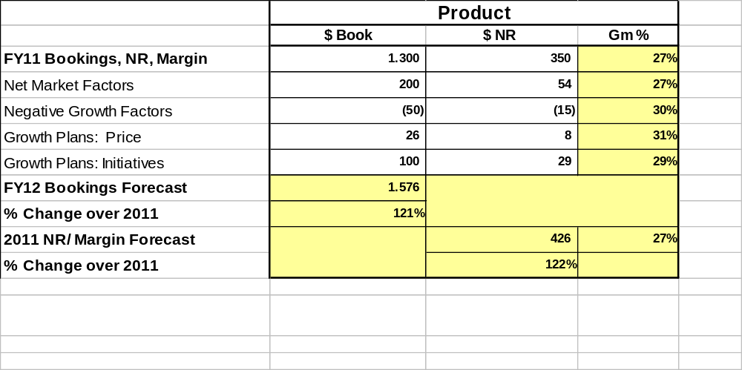
FY 2012 Forecast – RAI Division
Summation of Market and Growth Factors
INECO MR Confidential August 2011
Nota: las cifras de Booking y GM de este slide deben coincidir con las del slide 12
Notes:
Cells in yellow have formulas which will calculate the results

Slide 14
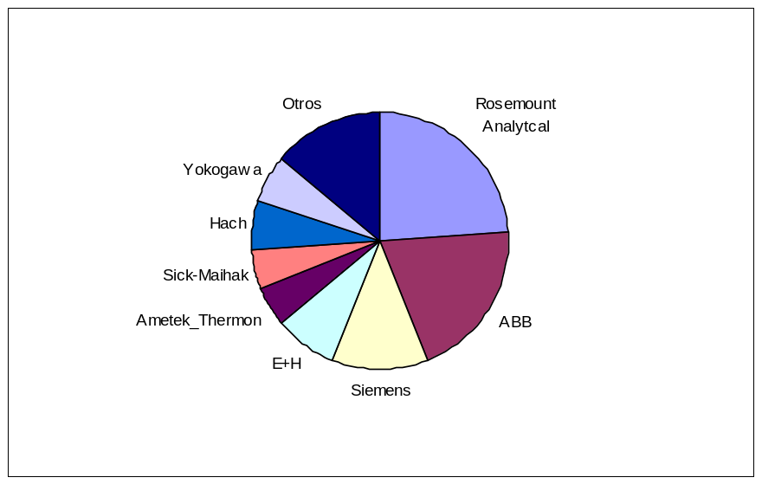
FY 2011 Forecast – Analytical Division
MRO and Project Forecast
INECO MR Confidential August 2010
1) MRO ANALYSIS
Rosemount Analytcal | 1920 | 24%
ABB | 1600 | 20%
Siemens | 960 | 12%
E+H | 640 | 8%
Ametek_Thermon | 400 | 5%
Sick-Maihak | 400 | 5%
Hach | 480 | 6%
Yokogawa | 480 | 6%
Otros | 1120 | 14%
2) PROJECTS FORECAST FY12
Project | End Customer | $ booking | $GM | %prob | $ Booking Forecast | Margin Forecast | GM%
Revamping Acid plant | Codelco | 320 | 83 | 50% | 160 | 42
N2O Reduction Panna 1 | Enaex | 320 | 85 | 70% | 224 | 60
Fuel Gas Analysis | Enap Aconcagua | 120 | 42 | 50% | 60 | 22
Treatment Sour fuel | Enap BB | 120 | 30 | 50% | 60 | 15
CEMS Tubogenerador | AES SFM | 120 | 30 | 50% | 60 | 15
Others |  | 500 | 135 | 50% | 250 | 67
 |  |  |  |  | 754 | 221 | 29%
Notes:
Cells in yellow have formulas which will calculate the results

Slide 15
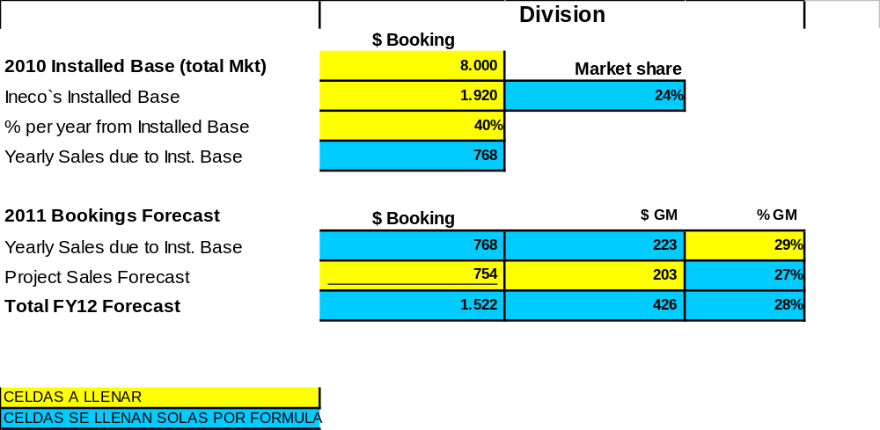
FY 2012 Forecast – Analytical Division
MRO and Project Forecast
INECO MR Confidential August 2010
Nota: las cifras de Booking y GM de este slide deben coincidir con las del slide 10
Notes:
Cells in yellow have formulas which will calculate the results

Slide 16
FY 2012 Forecast – FCS Division
Summary FY10-14
Puffer-Sweiven MR Confidential Sept 2009
 | FY10 | FY11 | FY12 | FY13 | FY14
Booking | 926 | 1300 | 1526 | 1820 | 2100
NR | 222 | 350 | 426 | 527 | 609

Slide 17
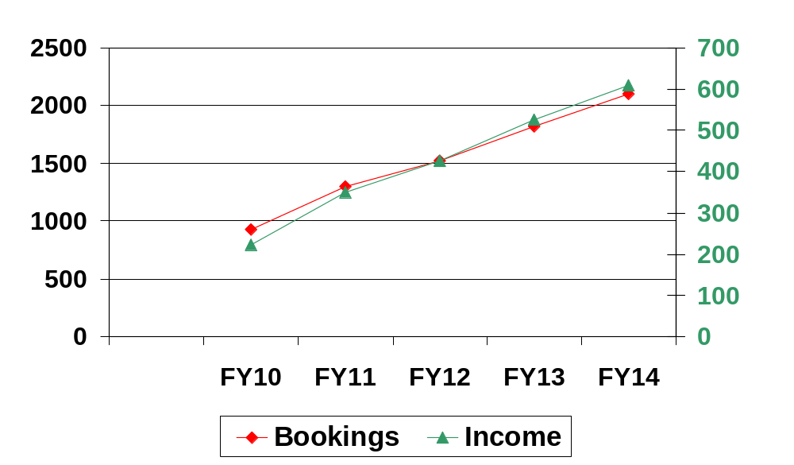
FY 2012 Forecast- FCS Division
Historical Trends
INECO MR Confidential August 2011
Notes:
Show the historical bookings, shipments and income for the team. Discuss the FY forecast in the light of the historical perspective.
INSTRUCTIONS:
Double click on the graph. You will get a dialogue box about installation of the graph features. Be patient – this takes a few dozen seconds to load. You will then get the excel sheet behind the graph that can be edited.
The scale will adjust to the actuals you put into the graph.
Income is plotted on the right axis.
Show historical numbers from Wired for 05 through 08, the projected finish for 09 and the forecasted finish for 2010.
When completed, click on the slide and the excel sheet closes.

Slide 18
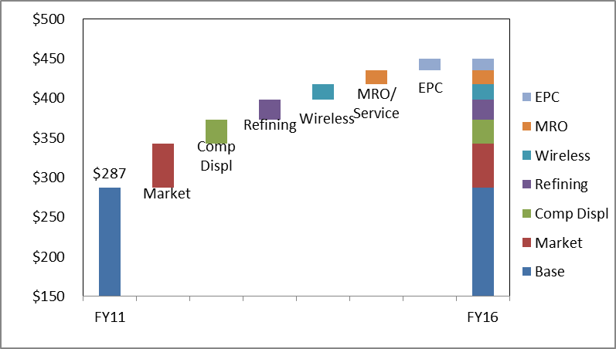
Example “Waterfall” Chart
FY14

Slide 19
FY12 Planning & Forecasting
Strategy
  Investments FY12-14
    Facilities
    Inventory
    Training
    Other CapEx
  Organization FY12-14
    Structure
    Personnel
    Development

Slide 20
Example Resources
People | FY11 | FY12 | FY13 | FY14
Outside Sales | 1 | 16 | 18 | 20
Inside Sales | 1 | 18 | 19 | 21
Admin | 15 | 16 | 17 | 18
Service | 7 | 10 | 11 | 12
Ops | 30 | 31 | 32 | 34
Capital | FY11 | FY12 | FY13 | FY14
Item 1 | $50K
Item 2 | $100K | $100K
Item 3 |  | $200K | $100K
Item 4 |  |  | $50K | $50K

